Slide 1
Only your own work goes live
PROCESS IMPROVEMENT
A safer, controlled way to release our data workflows (Airflow DAGs)
Notes:
Open with the one-line message: from now on, only the work a person has approved reaches production. Context for a non-technical audience: our data workflows (Airflow DAGs) are small programs that move and prepare company data every day. How those programs are released decides whether reports and data feeds stay trustworthy. This talk covers a risk we found, how we removed it, and who gains. About 8 minutes.

Slide 2
What went wrong: a simple story
Monday: Developer 1
Tuesday: Developer 2
The surprise
Finishes a change and releases it to the Test area only. It is still being checked. It should NOT go live yet.
Finishes a different change, tests it and releases it all the way to Production (live).
Developer 1's unchecked work went live too. Neither developer chose this, and neither could stop it.
Think of a delivery truck that takes every parcel in the warehouse, not just the one you booked.
Notes:
Walk through the three cards left to right. Monday: Developer 1 finishes a change and sends it to the Test area only, because it still needs checking. Tuesday: Developer 2 finishes a different change and releases it to Production. The surprise: because the old release step moved everything waiting, Developer 1's unchecked work went live too. Neither developer intended it and neither could prevent it. Use the delivery-truck analogy: you booked one parcel, but the truck took the whole warehouse.

Slide 3
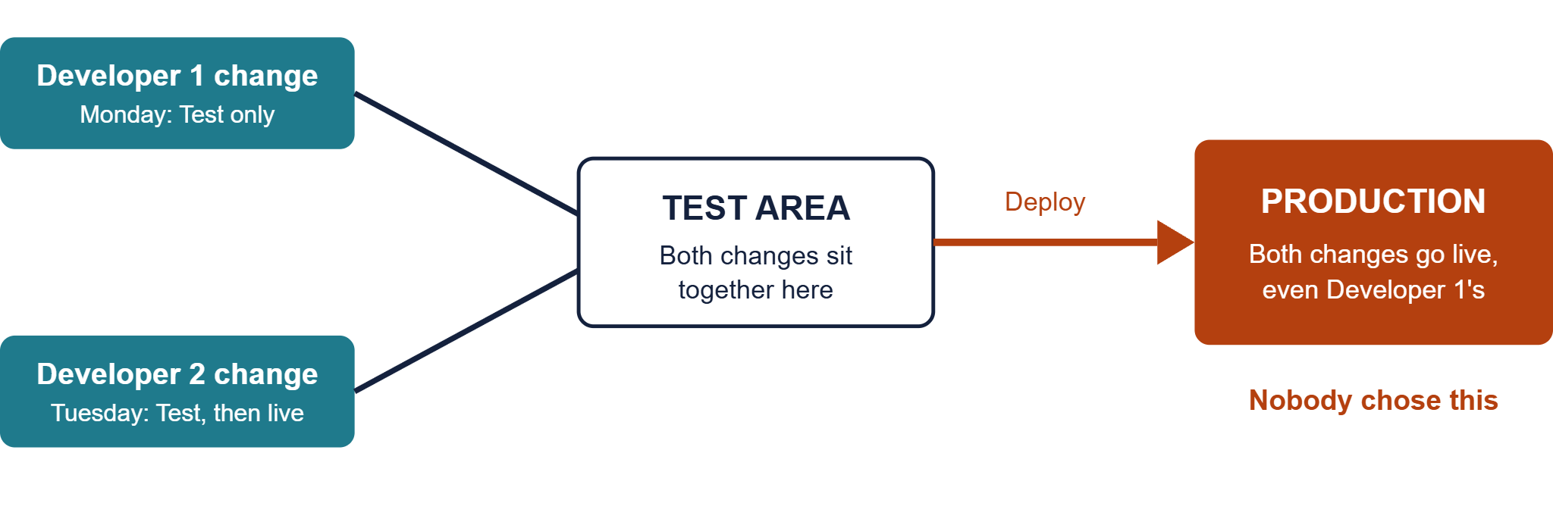
The old flow in one picture
Notes:
This is the same story as one picture. Two changes enter the Test area. They sit together there. One Deploy action moves the whole contents of Test to Production. The red box is the point: Developer 1's change is live although nobody decided that. Pause here and ask the room whether they would accept this in any other process, such as payments or contracts. This is a presentation simplification of the incident the team reported.

Slide 4
Problems with the old approach
Problem | In plain words
Unwanted code goes live | One person's release carries everyone else's pending work
No one is in control | A developer cannot choose to release only their own change
Wrong version in Production | A half-tested workflow can break live data jobs
No preview | Nobody sees what will be released before it happens
Deleted or renamed items linger | Old workflows keep running in Production by mistake
Hard to trace | Unclear who released what, and when
Notes:
Six problems, one per row, each with a plain meaning. The first three are the serious ones: unwanted code going live, nobody being able to control what they release, and half-tested workflows breaking live data jobs. The last three are about visibility: no preview of what will move, deleted or renamed workflows lingering in Production, and no clear trail of who released what. If asked for evidence, point to the real incident of a wrong workflow created in Test reaching Production.

Slide 5


Before and after
Before: everything together
After: one change at a time
Developer 1 work + Developer 2 work
Each change is reviewed, then merged
Everything pushed together
Only that change moves: Sandbox, Test, Production
Production: includes unchecked work
Production: only what was approved
Notes:
Left side is how releases behaved: everything together, so Production could contain unchecked work. Right side is the controlled approach: each change is reviewed, then only that change moves through Sandbox, Test and Production. Key sentence for managers: Production now receives only what was approved. Technical note if asked: the pipeline compares the newest merged version with the one just before it and copies only the files that differ.

Slide 6
How the new approach works
1. Preview
2. Approve and merge
3. Only changes move
4. Step by step
When a change is proposed, the system lists exactly which files will be released. Nothing is deployed yet.
Sandbox first, then Test, then Production. Each step waits for the one before to succeed.
A reviewer approves and merges the change into the main line.
The system compares with the previous version and copies only new, edited, renamed or removed files.
Approval checks can be added on Test and Production, so a person confirms before anything goes live.
Notes:
Four steps. 1 Preview: when someone opens a pull request, a check job prints the list of files that would be released. It deploys nothing. 2 Approve and merge: a reviewer approves, then the change is merged to main. Note for the presenter: the reviewer requirement is a branch policy set in Azure DevOps on main, not something written in the pipeline file, so confirm it is switched on. 3 Only changes move: the shared deploy template compares the latest version with the previous one and copies only added or modified files, removes deleted ones, and handles renames. 4 Step by step: the deploy to Test starts only if Sandbox succeeded, and Production only if Test succeeded. Approval checks on the Test and Production environments are also set in Azure DevOps.

Slide 7
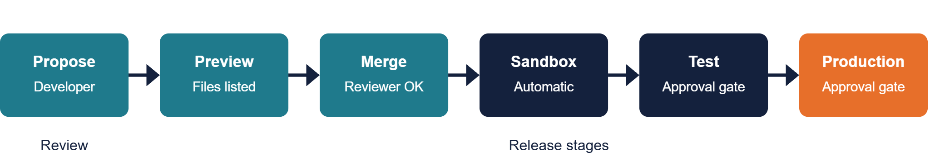
The new workflow, step by step
New or edited file
Copied to the target
Renamed file
Old removed, new copied
Deleted file
Removed from the target
Anything else
Left exactly as it is
Notes:
Read the chain left to right. Propose, Preview and Merge are the review part. Sandbox, Test and Production are the release part. The two orange or dark gates before Test and Production mean a named person can be required to click approve before the release continues; that setting lives on the environments in Azure DevOps. The four cards underneath explain, in plain words, what happens to each kind of file: new or edited files are copied, renamed files are moved, deleted files are removed, and everything else is left alone. That last point is exactly what protects against accidental side effects.

Slide 8
Who benefits
Developers
Business teams
Support and operations
Management and audit
Release only your own work, with confidence and no accidental side effects.
Fewer surprises in reports and data feeds because Production only gets approved work.
Fewer urgent fixes, and a clear record of what changed.
Controlled, traceable releases with approvals at each stage.
Notes:
Four audiences. Developers can release their own work with confidence. Business teams see fewer surprises in reports and data feeds. Support and operations get fewer urgent fixes and a clear record of what changed. Management and audit get controlled, traceable releases with approvals at each stage. These benefits are qualitative. If you have counts of past production incidents or hours spent on fixes, add them here for a stronger case.

Slide 9
Release only what is ready
Fewer production incidents, clearer ownership, and releases everyone can trust.
Ask: approve rollout to all Airflow projects.
Notes:
Summarise in one sentence: release only what is ready. Then make the ask clearly: approval to roll this approach out to all Airflow projects. Offer to answer questions and to share the technical walk-through with the engineering leads. Before presenting, confirm that the Sandbox, Test and Production buckets and key files are set to their real separate values, and that branch policy and environment approvals are enabled.

